Slide 1
AdaNet for Concrete Strength prediction

Slide 2
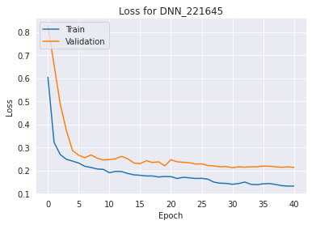
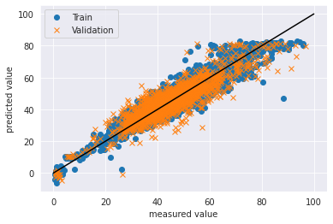
DNN
Batch Size: 128
# of Layers: 5
# of Node: 64
cv_r2: 0.7954
cv_mse: 28.88
cv_rmse: 5.37
train_r2: 0.8865
train_mse: 15.30
train_rmse: 3.911

Slide 3
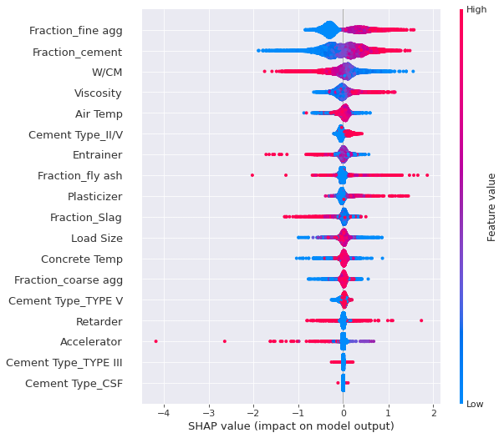
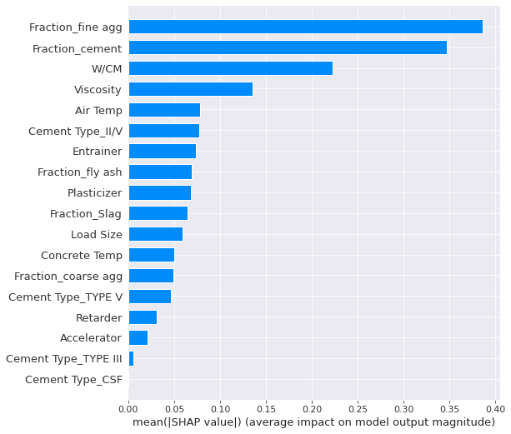
Shap Summary Plot

Slide 4
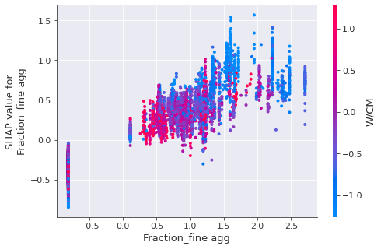
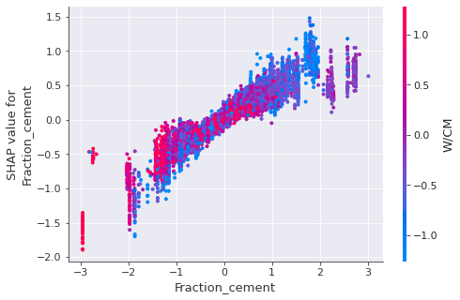
Shap Dependence Plot

Slide 5
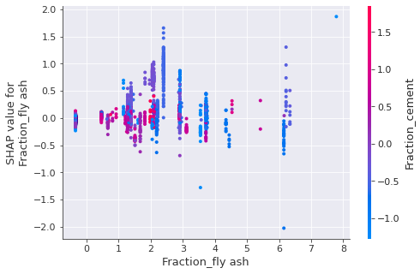
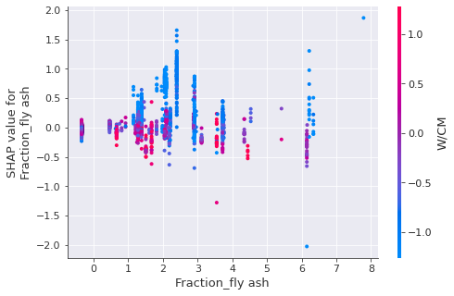
Shap Dependence Plot

Slide 6
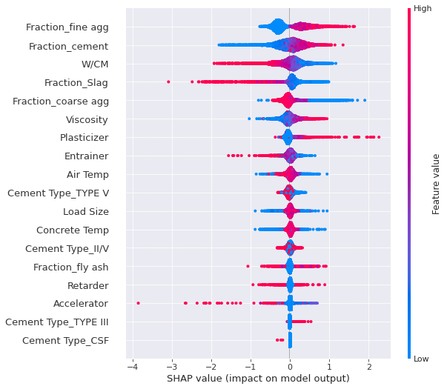
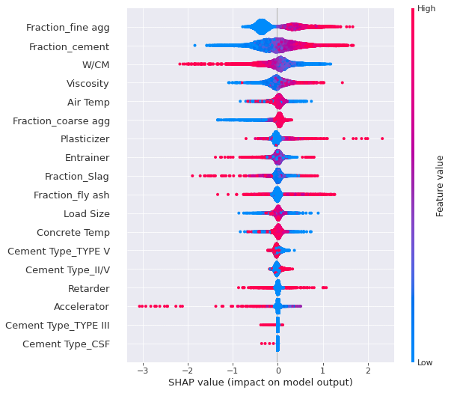
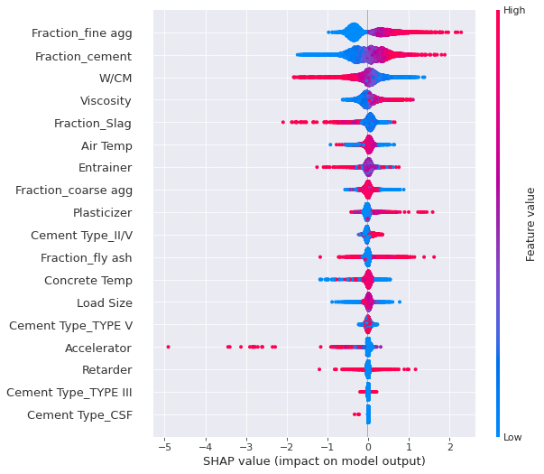
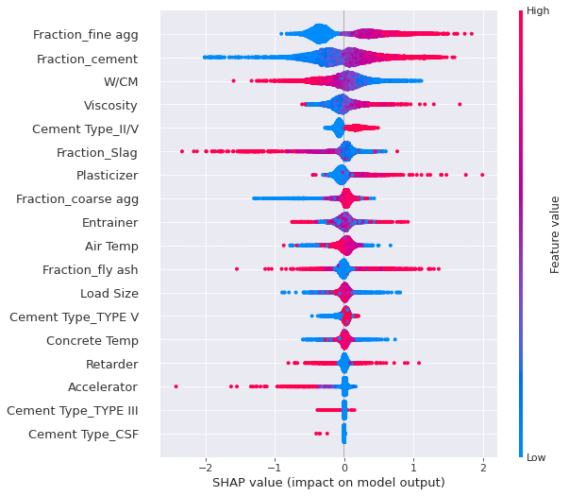
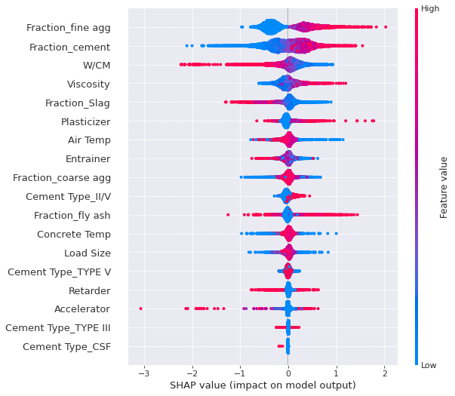
DNN - Shap Plot
R2 mean: 0.8141 , STD: 0.01921
MSE mean: 25.320 , STD: 2.244
RMSE mean: 5.028, STD: 0.220

Slide 7
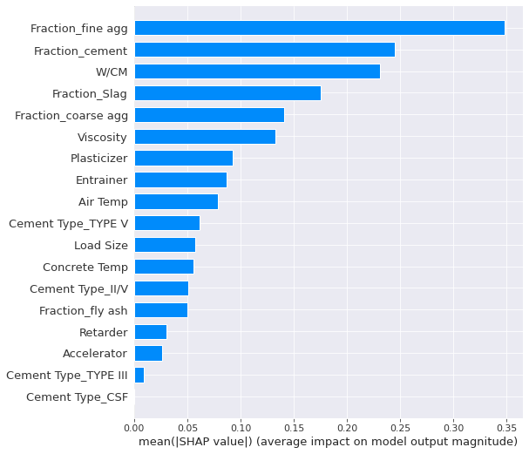
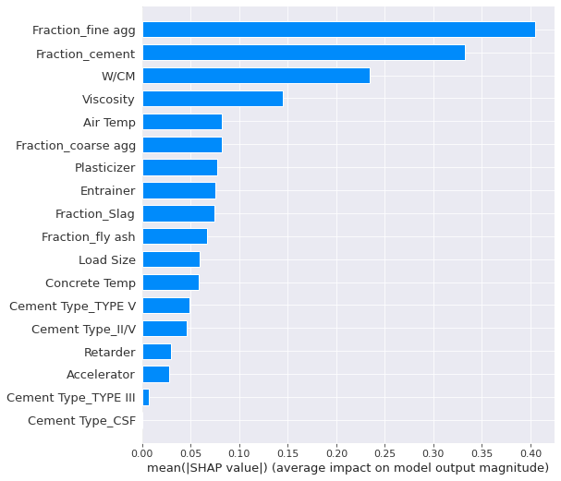
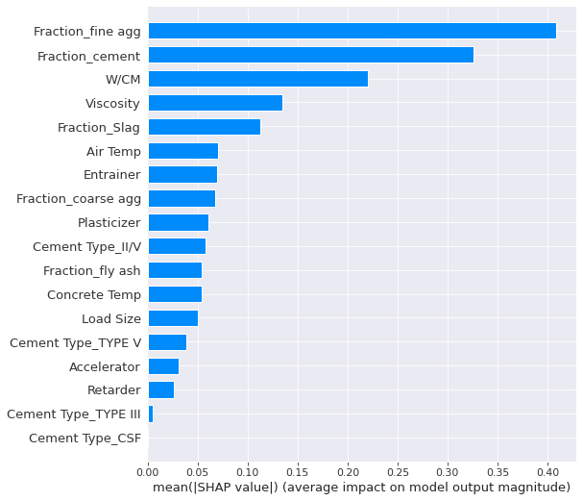
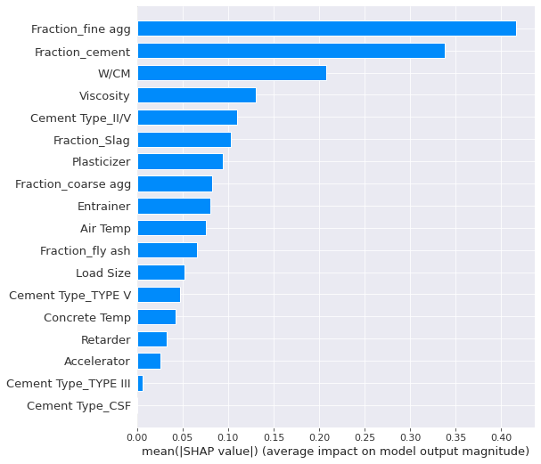
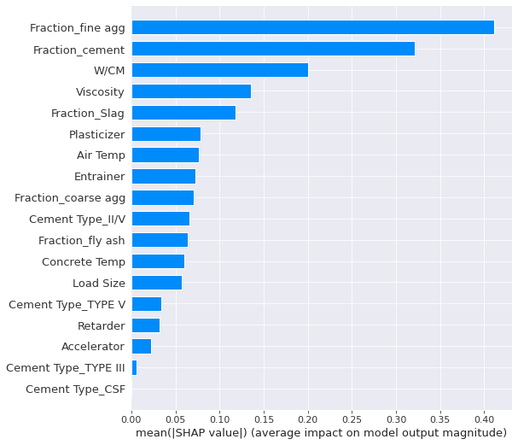
DNN - Shap Plot
R2 mean: 0.8141 , STD: 0.01921
MSE mean: 25.320 , STD: 2.244
RMSE mean: 5.028, STD: 0.220

Slide 8
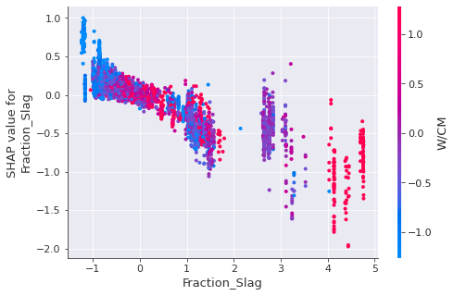
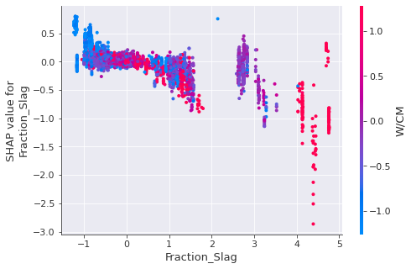
Shap plot - Slag
CV 1
CV 2

Slide 9
